Slide 1
LINQ
Thien Khai Tran

Slide 2
What is LINQ?
LINQ (Language Integrated Query) is uniform query syntax in C# (or VB.NET) used to save and retrieve data from different sources.
LINQ always works with objects so you can use the same basic coding patterns to query and transform data in XML documents, SQL databases, ADO.NET Datasets, .NET collections, and any other format for which a LINQ provider is available.

Slide 3
Advantages of LINQ
Familiar language: Developers don’t have to learn a new query language for each type of data source or data format.
Less coding: It reduces the amount of code to be written as compared with a more traditional approach.
Readable code: LINQ makes the code more readable so other developers can easily understand and maintain it.
Standardized way of querying multiple data sources: The same LINQ syntax can be used to query multiple data sources.
IntelliSense Support: LINQ provides IntelliSense for generic collections.
Shaping data: You can retrieve data in different shapes.

Slide 4
LINQ API
Use System.Linq namespace to use LINQ.
LINQ API includes two main static class Enumerable & Queryable.
The static Enumerable class includes extension methods for classes that implements IEnumerable<T> interface.
  IEnumerable<T> type of collections are in-memory collection like List, Dictionary, SortedList, Queue, HashSet, LinkedList
The static Queryable class includes extension methods for classes that implements IQueryable<T> interface
  Remote query provider implements IQueryable<T>. eg. Linq-to-SQL, LINQ-to-Amazon etc.
Notes:
The main difference between “IEnumerable” and “IQueryable” is about where the filter logic is executed. One executes on the client side (in memory) and the other executes on the database.

Slide 5
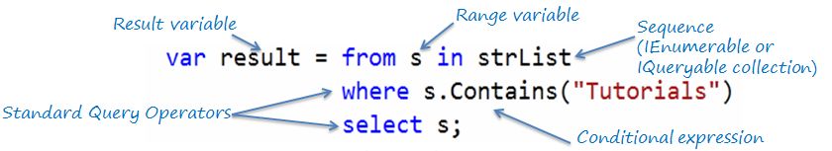
LINQ Query Syntax
There are two basic ways to write a LINQ query to IEnumerable collection or IQueryable data sources.
Query Syntax or Query Expression Syntax
Method Syntax or Method extension syntax or Fluent
Notes:
LINQ Query Syntax:
from <range variable> in <IEnumerable<T> or IQueryable<T> Collection> <Standard Query Operators> <lambda expression> <select or groupBy operator> <result formation>
IQueryable kế thừa IEnumerable, vì thế IQueryable có tất cả các đặc tính của IEnumerable và có thêm các đặc tính của riêng nó.
IQueryable tốt nhất cho truy vấn dữ liệu out-memory như là database. IEnumerable tốt nhất khi truy vấn từ một collection in-memory tức là trong bộ nhớ RAM như List, Array…

Slide 6
// string collection
IList<string> stringList = new List<string>() {
"C# Tutorials",
"VB.NET Tutorials",
"Learn C++",
"MVC Tutorials" ,
"Java"
};
// LINQ Query Syntax
var result = from s in stringList
where s.Contains("Tutorials")
select s;
Notes:
String

Slide 7
// Student collection
IList<Student> studentList = new List<Student>>() {
new Student() { StudentID = 1, StudentName = "John", Age = 13} ,
new Student() { StudentID = 2, StudentName = "Moin", Age = 21 } ,
new Student() { StudentID = 3, StudentName = "Bill", Age = 18 } ,
new Student() { StudentID = 4, StudentName = "Ram" , Age = 20} ,
new Student() { StudentID = 5, StudentName = "Ron" , Age = 15 }
};
// LINQ Query Syntax to find out teenager students
var teenAgerStudent = from s in studentList
where s.Age > 12 && s.Age < 20
select s;
Notes:
OBJECT

Slide 8
LINQ Query Syntax
As name suggest, Query Syntax is same like SQL (Structure Query Language) syntax.
Query Syntax starts with from clause and can be end with Select or GroupBy clause.
Use various other operators like filtering, joining, grouping, sorting operators to construct the desired result.
Implicitly typed variable - var can be used to hold the result of the LINQ query.

Slide 9

LINQ Method Syntax
Method syntax (also known as fluent syntax) uses extension methods included in the Enumerable or Queryable static class, similar to how you would call the extension method of any class.

Slide 10
// string collection
IList<string> stringList = new List<string>() {
"C# Tutorials",
"VB.NET Tutorials",
"Learn C++",
"MVC Tutorials" ,
"Java"
};
// LINQ Query Syntax
var result = stringList.Where(s => s.Contains("Tutorials"));

Slide 11
// Student collection
IList<Student> studentList = new List<Student>() {
new Student() { StudentID = 1, StudentName = "John", Age = 13} ,
new Student() { StudentID = 2, StudentName = "Moin", Age = 21 } ,
new Student() { StudentID = 3, StudentName = "Bill", Age = 18 } ,
new Student() { StudentID = 4, StudentName = "Ram" , Age = 20} ,
new Student() { StudentID = 5, StudentName = "Ron" , Age = 15 }
};
// LINQ Method Syntax to find out teenager students
var teenAgerStudents = studentList.Where(
s => s.Age > 12 && s.Age < 20
).ToList<Student>();

Slide 12
LINQ Method Syntax
As name suggest, Method Syntax is like calling extension method.
LINQ Method Syntax aka Fluent syntax because it allows series of extension methods call.
Implicitly typed variable - var can be used to hold the result of the LINQ query.

Slide 13
Standard Query Operators
Standard Query Operators in LINQ are actually extension methods for the IEnumerable<T> and IQueryable<T> types. They are defined in the System.Linq.Enumerable and System.Linq.Queryable classes.
There are over 50 standard query operators available in LINQ that provide different functionalities like filtering, sorting, grouping, aggregation, concatenation, etc.

Slide 14
Standard Query Operators
Classification Standard Query Operators
Filtering Where, OfType
Sorting OrderBy, OrderByDescending, ThenBy, ThenByDescending, Reverse
Grouping GroupBy, ToLookup
Join GroupJoin, Join
Projection Select, SelectMany
Aggregation Aggregate, Average, Count, LongCount, Max, Min, Sum
Quantifiers All, Any, Contains
Elements ElementAt, ElementAtOrDefault, First, FirstOrDefault, Last, LastOrDefault, Single, SingleOrDefault
Set Distinct, Except, Intersect, Union
Partitioning Skip, SkipWhile, Take, TakeWhile
Concatenation Concat
Equality SequenceEqual
Generation DefaultEmpty, Empty, Range, Repeat
Conversion AsEnumerable, AsQueryable, Cast, ToArray, ToDictionary, ToList

Slide 15
WHERE
IList<Student> studentList = new List<Student>() {
new Student() { StudentID = 1, StudentName = "John", Age = 13} ,
new Student() { StudentID = 2, StudentName = "Moin", Age = 21 } ,
new Student() { StudentID = 3, StudentName = "Bill", Age = 18 } ,
new Student() { StudentID = 4, StudentName = "Ram" , Age = 20} ,
new Student() { StudentID = 5, StudentName = "Ron" , Age = 15 }
};
var filteredResult = from s in studentList
where s.Age > 12 && s.Age < 20
select s.StudentName;

Slide 16
SELECT
IList<Student> studentList = new List<Student>() {
new Student() { StudentID = 1, StudentName = "John", Age = 13 } ,
new Student() { StudentID = 4, StudentName = "Ram" , Age = 20 } ,
new Student() { StudentID = 5, StudentName = "Ron" , Age = 15 }
};
// returns collection of anonymous objects with Name and Age property
var selectResult = from s in studentList
select new { Name = "Mr. " + s.StudentName, Age = s.Age };
// iterate selectResult
foreach (var item in selectResult)
Console.WriteLine("Student Name: {0}, Age: {1}", item.Name, item.Age);
Notes:
Student Name: Mr. John, Age: 13
Student Name: Mr. Moin, Age: 21

Slide 17
SELECT
IList<Student> studentList = new List<Student>() {
new Student() { StudentID = 1, StudentName = "John", Age = 18 } ,
new Student() { StudentID = 2, StudentName = "Moin", Age = 21 } ,
new Student() { StudentID = 3, StudentName = "Bill", Age = 18 } ,
new Student() { StudentID = 4, StudentName = "Ram" , Age = 20 } ,
new Student() { StudentID = 5, StudentName = "Ron" , Age = 21 }
};
var selectResult = studentList.Select(
s => new { Name = s.StudentName ,
Age = s.Age }
);
Notes:
[0] {Name=“John”, Age=18}

Slide 18
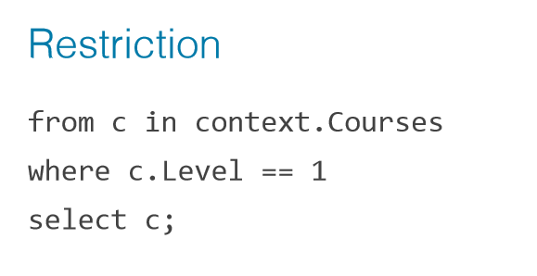
LINQ Query Syntax

Slide 19
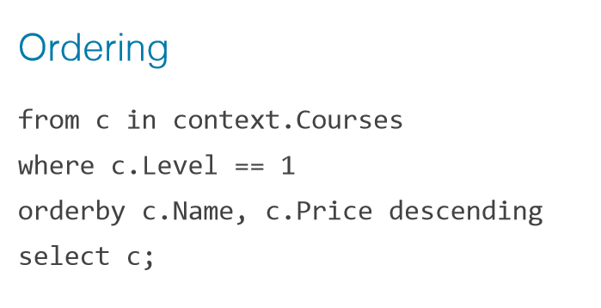
LINQ Query Syntax

Slide 20
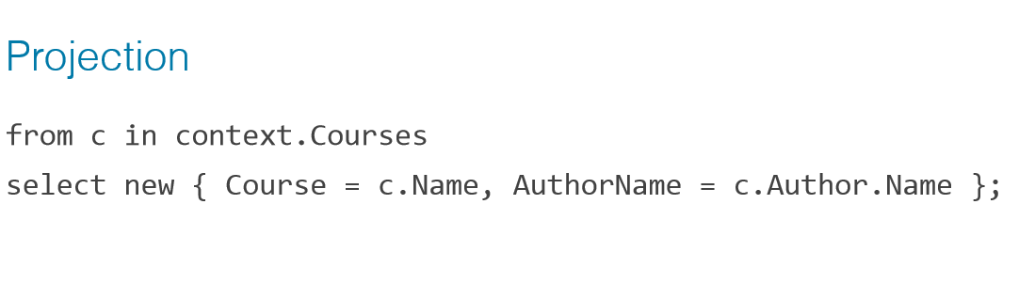
LINQ Query Syntax

Slide 21
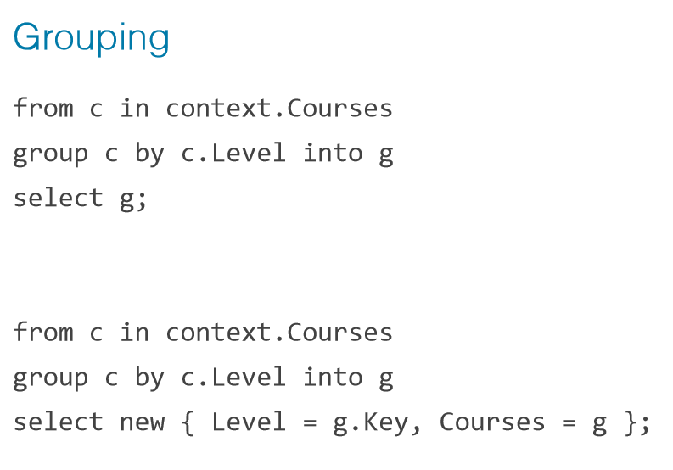
LINQ Query Syntax

Slide 22
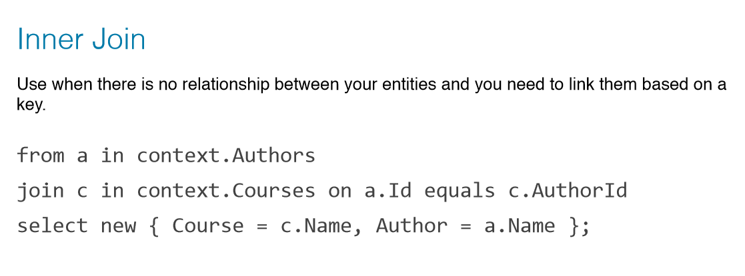
LINQ Query Syntax

Slide 23
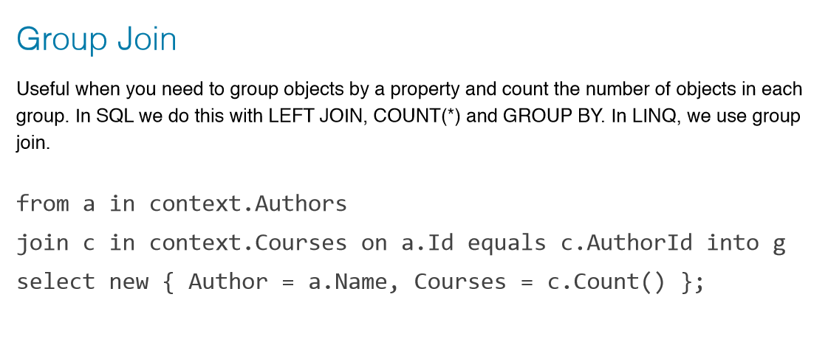
LINQ Query Syntax

Slide 24
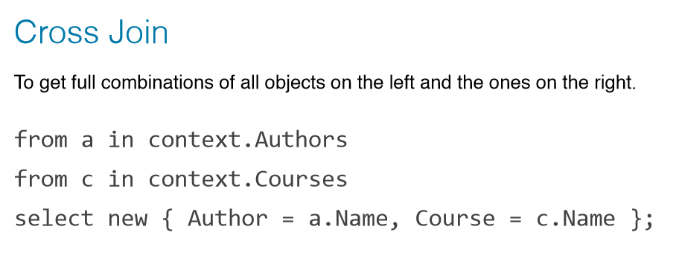
LINQ Query Syntax

Slide 25
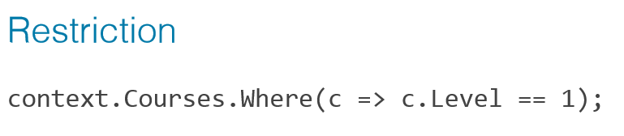
LINQ Method Syntax

Slide 26
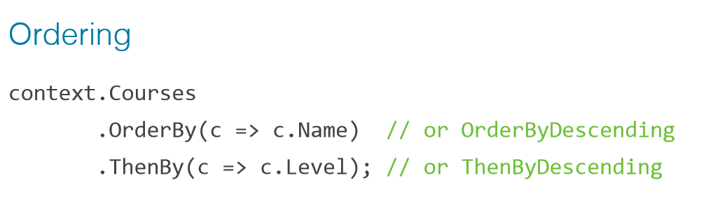
LINQ Method Syntax

Slide 27
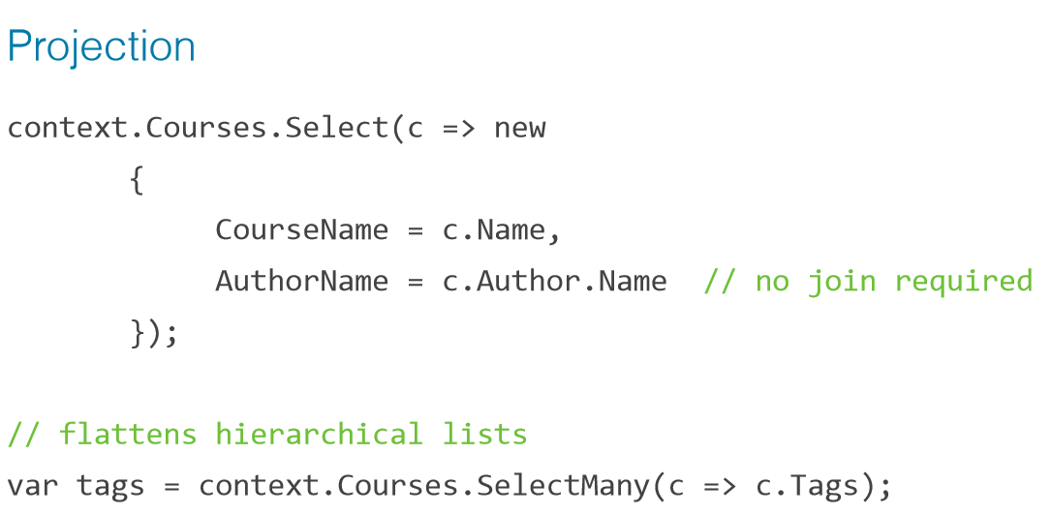
LINQ Method Syntax

Slide 28
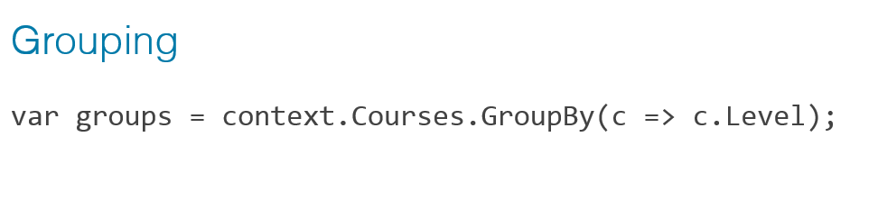
LINQ Method Syntax

Slide 29
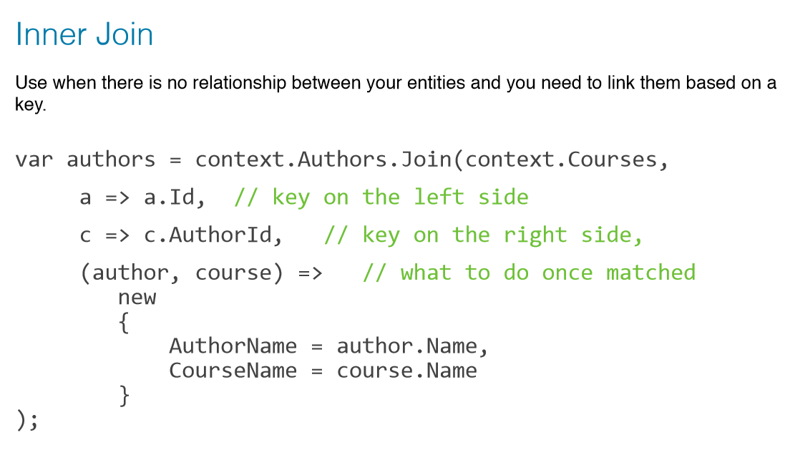
LINQ Method Syntax

Slide 30
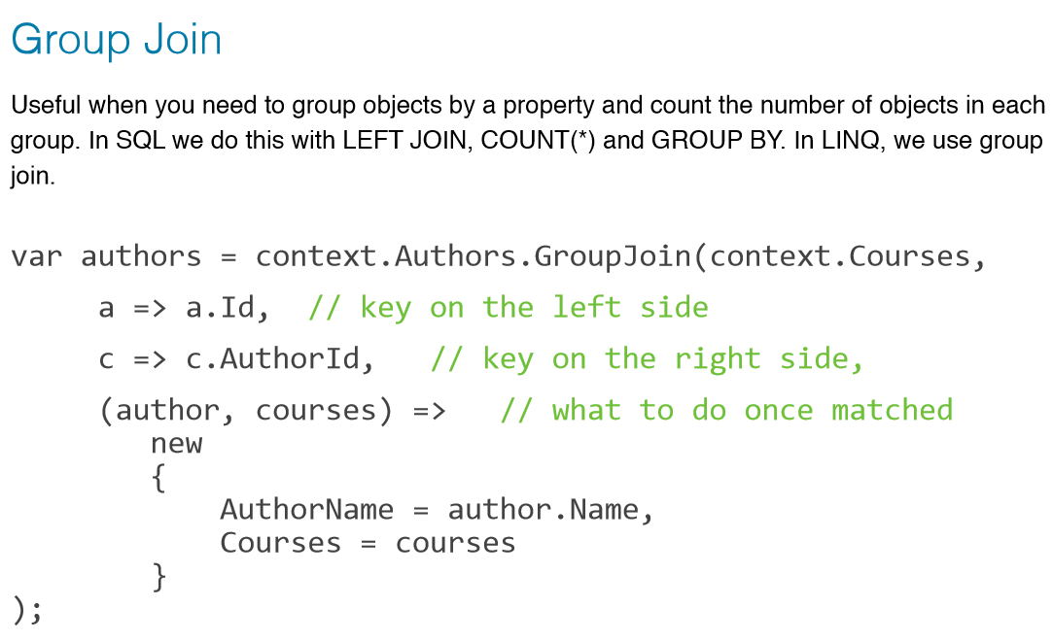
LINQ Method Syntax

Slide 31
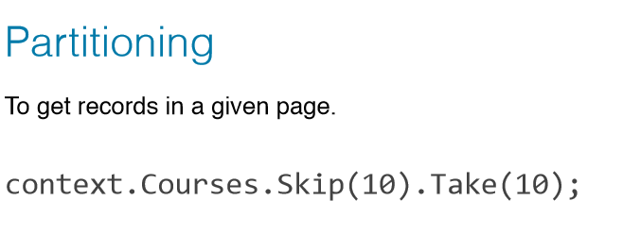
LINQ Method Syntax

Slide 32
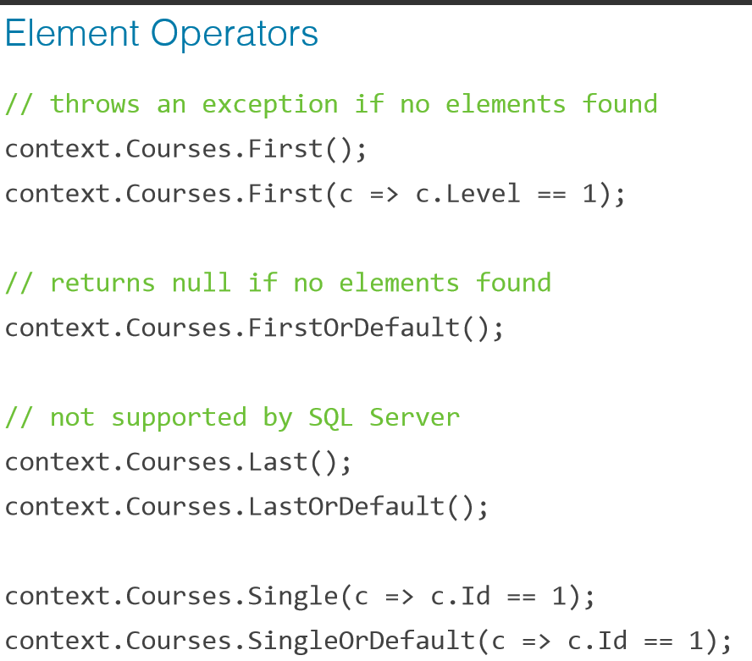
LINQ Method Syntax

Slide 33
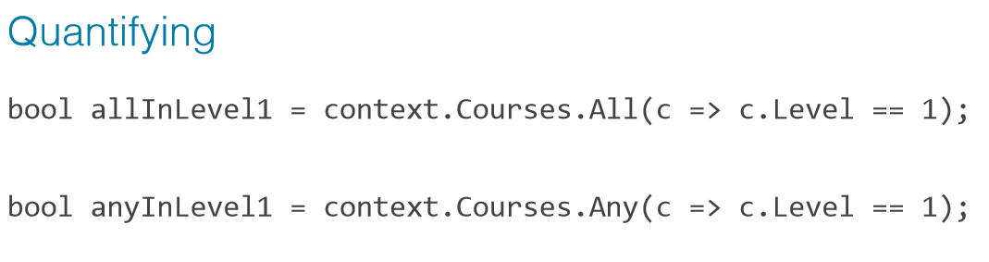
LINQ Method Syntax

Slide 34
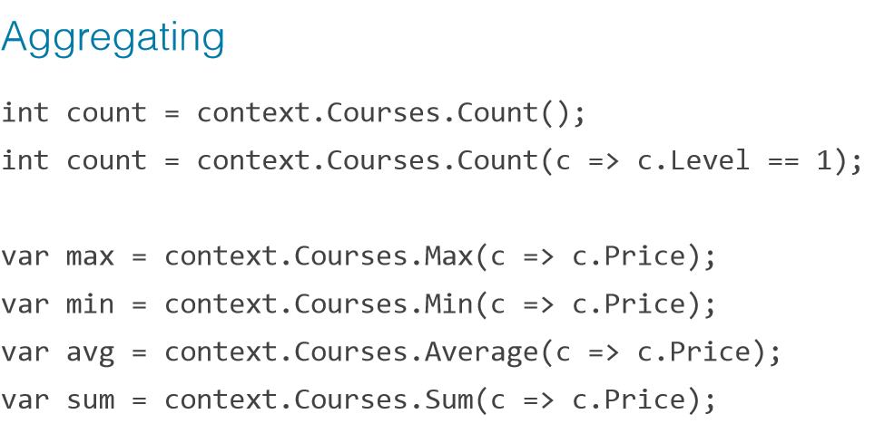
LINQ Method Syntax

Slide 36
var query =
from c in db.Customers
where c.Name.StartsWith ("A")
orderby c.Name
select c.Name.ToUpper();
var thirdPage = query.Skip(20).Take(10);
SELECT TOP 10 UPPER (c1.Name)
FROM Customer c1
WHERE
c1.Name LIKE 'A%'
AND c1.ID NOT IN
(
SELECT TOP 20 c2.ID
FROM Customer c2
WHERE c2.Name LIKE 'A%'
ORDER BY c2.Name
)
ORDER BY c1.Name

Slide 37
SELECT
p.Description,
s.Name,
(SELECT COUNT(*) FROM PurchaseItem pi WHERE p.ID = pi.PurchaseID) PurchaseItemCount
FROM Purchase p
LEFT OUTER JOIN
Customer c
INNER JOIN Address a ON c.AddressID = a.ID
LEFT OUTER JOIN SalesPerson s ON c.SalesPersonID = s.ID
ON p.CustomerID = c.ID
WHERE
(a.State = 'WA' OR p.CustomerID IS NULL)
AND p.ID in
(
SELECT PurchaseID FROM PurchaseItem
GROUP BY PurchaseID HAVING SUM (SaleAmount) > 1000
)
ORDER BY
(SELECT SUM (SaleAmount) FROM PurchaseItem pi WHERE p.ID = pi.PurchaseID) DESC
from p in db.Purchases
where p.Customer.Address.State == "WA" || p.Customer == null
let purchaseValue = p.PurchaseItems.Sum (pi => pi.SaleAmount)
where purchaseValue > 1000
orderby purchaseValue descending
select new
{
p.Description,
p.Customer.SalesPerson.Name,
PurchaseItemCount = p.PurchaseItems.Count()
}
from c in db.Customers
where c.Address.State == "WA"
select new
{
c.Name,
c.CustomerNumber,
HighValuePurchases = c.Purchases.Where (p => p.Price > 1000)

Slide 38
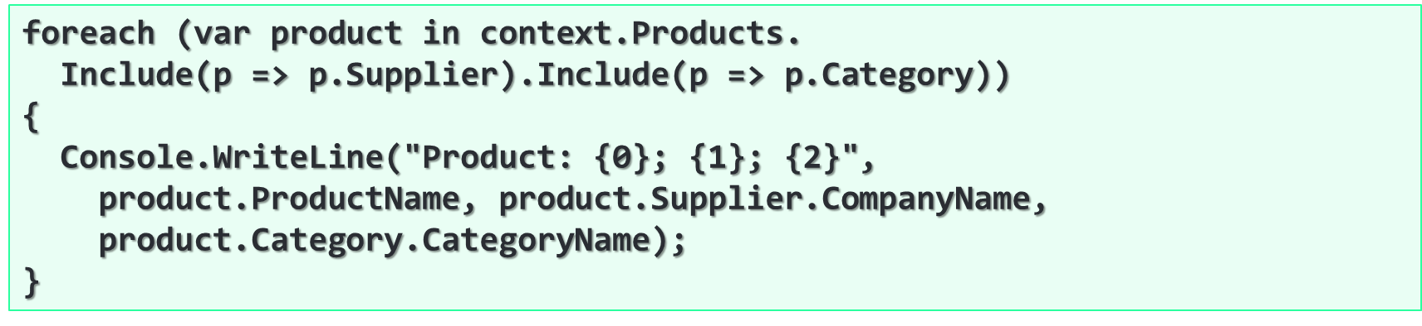
foreach (var product in context.Products)
{
Console.WriteLine("Product: {0}; {1}; {2}",
product.ProductName, product.Supplier.CompanyName,
product.Category.CategoryName);
}
Notes:
Solution to the N+1 Query Problem
Imagine we have 100 products in the database
That's ~ 201 SQL queries → very slow!
We could do the same with a single SQL query

Slide 39
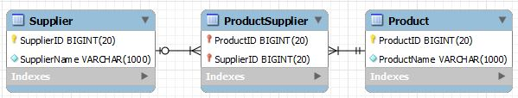
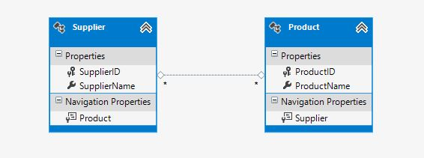
Model and Mapping

Slide 40
namespace ManyToMany.Model
{
using System;
using System.Collections.Generic;
public partial class Product
{
public Product()
{
this.Supplier = new HashSet&lt;supplier>();
}
public long ProductID { get; set; }
public string ProductName { get; set; }
//navigation property to Supplier
public virtual ICollection&lt;supplier> Supplier { get; set; }
}
}
namespace ManyToMany.Model
{
using System;
using System.Collections.Generic;
public partial class Supplier
{
public Supplier()
{
this.Product = new HashSet&lt;product>();
}
public long SupplierID { get; set; }
public string SupplierName { get; set; }
// navigation property to Product
public virtual ICollection&lt;product> Product { get; set; }
}
}

Slide 41
public void InsertWithoutData(Product prod, Supplier sup)
{
using (ManyToManyEntities conn = new ManyToManyEntities())
{
//add instances to context
conn.Product.Add(prod);
conn.Supplier.Add(sup);
// add instance to navigation property
prod.Supplier.Add(sup);
//call SaveChanges from context to confirm inserts
conn.SaveChanges();
}
}

Slide 42
public void InsertWithData(long productID, long supplierID)
{
using (ManyToManyEntities conn = new ManyToManyEntities())
{
// 1
Product p = new Product { ProductID = productID };
// 2
conn.Product.Add(p);
// 3
conn.Product.Attach(p);
// 1
Supplier s = new Supplier { SupplierID = supplierID };
// 2
conn.Supplier.Add(s);
// 3
conn.Supplier.Attach(s);
// like previous method add instance to navigation property
p.Supplier.Add(s);
// call SaveChanges
conn.SaveChanges();
}
}

Slide 43
public void DeleteRelationship(long productID, long supplierID)
{
using (ManyToManyEntities conn = new ManyToManyEntities())
{
// return one instance each entity by primary key
var product = conn.Product.FirstOrDefault(p => p.ProductID == productID);
var supplier = conn.Supplier.FirstOrDefault(s => s.SupplierID == supplierID);
// call Remove method from navigation property for any instance
// supplier.Product.Remove(product);
// also works
product.Supplier.Remove(supplier);
// call SaveChanges from context
conn.SaveChanges();
}
}

Slide 44
public void UpdateRelationship(long oldProductID, long oldSupplierID,
long newProductID, long newSupplierID)
{
DeleteRelationship(oldProductID, oldSupplierID);
InsertWithData(newProductID, newSupplierID);
}

Slide 45
public List&lt;dtogenericobject> GetProductBySupplier(long supplierID)
{
using (ManyToManyEntities conn = new ManyToManyEntities())
{
var result = (
// instance from context
from a in conn.Supplier
// instance from navigation property
from b in a.Product
//join to bring useful data
join c in conn.Product on b.ProductID equals c.ProductID
where a.SupplierID == supplierID
select new DTOGenericObject
{
ID = c.ProductID,
Name = c.ProductName
}).ToList();
return result;
}
}

